Slide 1

Hot-Wiring of the Future: Exploring Car CAN Buses
Sponsored by:
ENGS 89/90: Final Presentation
Chris Hoder
Ted Sumers
Grayson Zulauf
7 March 2013
Notes:
Cover Page

Slide 2

Background
Automobiles as complex, highly-connected networks
engineering.dartmouth.edu 7 March 2013

Slide 3
Problem Statement
Problem:
Safety-critical information is transmitted on an unauthenticated network. Adversaries could exploit this with unknown consequences.
Need:
A better understanding of the scope of the problem and tools to further explore the space.
engineering.dartmouth.edu 7 March 2013

Slide 4
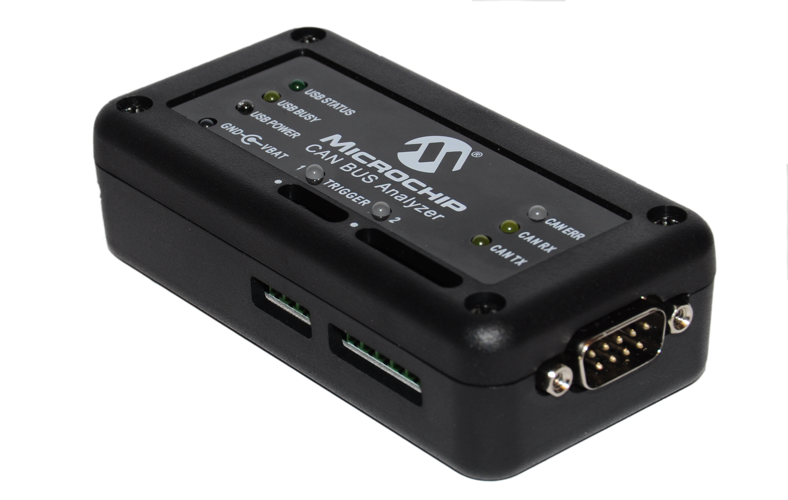
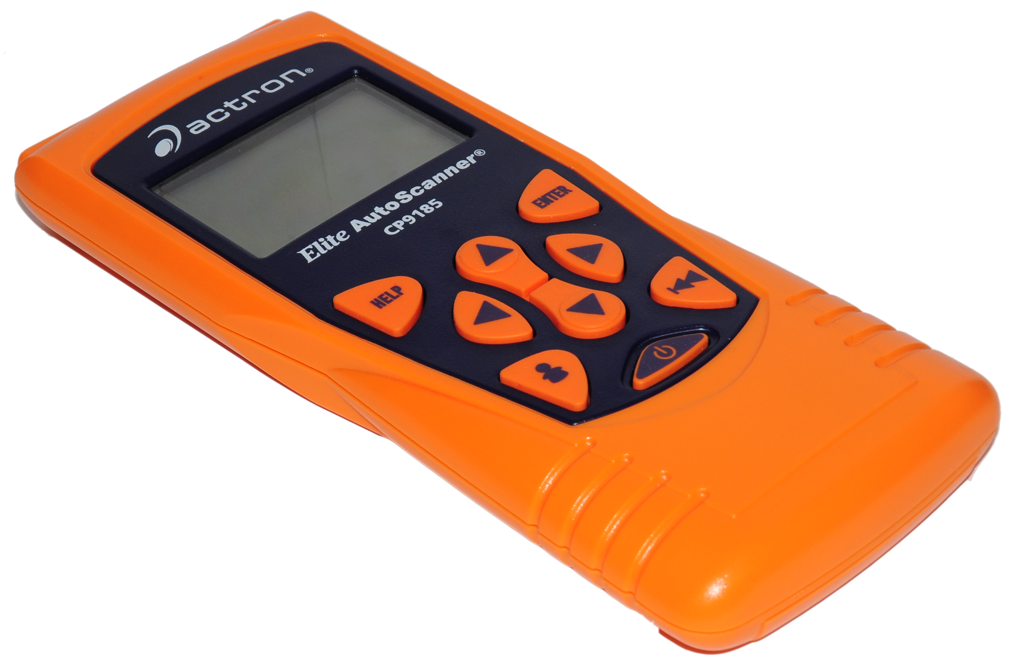
State of the Art
CAN Protocol Analyzers
Inexpensive (<$200)
Handheld, Basic Diagnostics
Simple debugging
Midrange ($200-500)
Link to computer
More sophisticated analysis (horsepower, torque, mileage)
Advanced (>$2500, licensed by manufacturer)
In-depth analysis
Writing capabilities
Re-flash ECU firmware
engineering.dartmouth.edu 7 March 2013

Slide 5
State of the Art – Academic Research
To carry out an attack, an adversary must have all of the following:
Incentive
Toehold
Identified Exploits
engineering.dartmouth.edu 7 March 2013

Slide 6
State of the Art – Academic Research
To carry out an attack, an adversary must have all of the following:
Project Scope
Incentive
Toehold
Identified Exploits
Identified
OBD-II Port
engineering.dartmouth.edu 7 March 2013

Slide 7
Explore potential market for automotive security products.
engineering.dartmouth.edu 7 March 2013

Slide 8
Explore potential market for automotive security products.
Prove Vulnerability
Further Research
engineering.dartmouth.edu 7 March 2013

Slide 9
Explore potential market for automotive security products.
Prove Vulnerability
Further Research
Proof-of-Concept:
Demo Hack
Methodology
Software Package
engineering.dartmouth.edu 7 March 2013

Slide 10

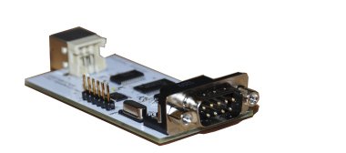
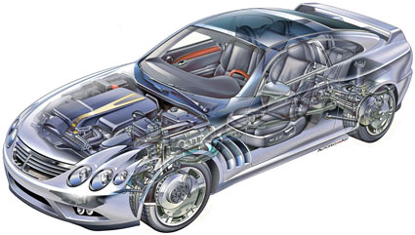

Software Package: Goals
Software Package
GoodThopter10
CAN Bus
User
engineering.dartmouth.edu 7 March 2013

Slide 11
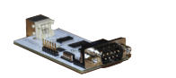

Read/Write Capability
Software Package
Data Management
User Interface
engineering.dartmouth.edu 7 March 2013

Slide 12
Reverse-Engineering the CAN Bus
General Network Attack Methodology
Passive Listening
Incentive
Toehold
Physical Stimuli
Attack
Active Probing
Identify Exploits
engineering.dartmouth.edu 7 March 2013

Slide 13
Work Accomplished - Methodology
Background Characterization
Correlation with Physical Stimuli
Packet Injection
engineering.dartmouth.edu 7 March 2013

Slide 14
Work Accomplished - Methodology
Arbitration ID Sweep
RTR Sweep
Unfiltered Sniff
Filtered Sniff
Background Characterization
Correlation with Physical Stimuli
Packet Injection
engineering.dartmouth.edu 7 March 2013

Slide 15
Work Accomplished - Methodology
Arbitration ID Sweep
RTR Sweep
Unfiltered Sniff
Filtered Sniff
ArbID | 512 | 513 | 529 | 530 | 560 | 1056 | 1057 | 1072 | 1248 | 1279
Freq (packets/second) | 115 | 62 | 50 | 50 | 112 | 10 | 0.2 | 50 | 1 | 1
engineering.dartmouth.edu 7 March 2013

Slide 16
Work Accomplished - Methodology
Arbitration ID Sweep
RTR Sweep
Unfiltered Sniff
Filtered Sniff
A Case Study – ID 513
ArbID | Frequency (packets/second) | Background Packets
513 | 62 | 12 xx 125 xx 39 16 0 125
*xx = varying
engineering.dartmouth.edu 7 March 2013

Slide 17
Work Accomplished - Methodology
Background Characterization
Correlation with Physical Stimuli
Packet Injection
engineering.dartmouth.edu 7 March 2013

Slide 18
Work Accomplished - Methodology
Background Characterization
Correlation with Stimuli
System Perturbation
Characterize Change with Stimuli
List of Perturbations
Packet Injection
engineering.dartmouth.edu 7 March 2013

Slide 19
Work Accomplished - Methodology
System Perturbation
Characterize Change with Stimuli
A Case Study – ID 513
ArbID | Perturbation Response | Data Byte Correlation
513 | Revving Engine | Bytes 0, 1
 | Increase while driving | Byte 4
engineering.dartmouth.edu 7 March 2013

Slide 20
Work Accomplished - Methodology
Background Characterization
Correlation with Physical Stimuli
Packet Injection
engineering.dartmouth.edu 7 March 2013

Slide 21
Work Accomplished - Methodology
Background Characterization
Correlation with Physical Stimuli
Packet Injection
Confirm Inferences, Test Responsiveness
Boundary Analysis
Generative Fuzzing
Confirm New Inferences

Slide 22
Work Accomplished - Methodology
Confirm Inferences, Test Responsiveness
Boundary Analysis
Generative Fuzzing
Confirm New Inferences
A Case Study – ID 513
ArbID | Fuzzing Response | Refined Inferences
513 | Dashboard components change | Bytes 0, 1 = RPM
 |  | Byte 4 = Speedometer
engineering.dartmouth.edu 7 March 2013

Slide 23
Higher Level Protocol: ID 513
engineering.dartmouth.edu 7 March 2013

Slide 24
Higher Level Protocol: ID 1056
1056
DLC = 8
SOF
Arbitration ID
Control Field
Data Field
EOF
Engine Temp
Odometer
Battery Charge
Engine Clock
Dashboard Warnings
Check Fuel Cap
Unused
Counter
engineering.dartmouth.edu 7 March 2013

Slide 25
Read/Write Capability
Software Package
Data Management
User Interface
engineering.dartmouth.edu 7 March 2013

Slide 26
Video
engineering.dartmouth.edu 4 March 2013
Notes:
This is the youtube video.

Slide 27
User Interface: Design Considerations
engineering.dartmouth.edu 7 March 2013

Slide 28
Raw CAN Data
Raw CAN Data
Simple communications with Goodthopter10
Digital Logic communications
Generic Analysis Tools
Generic Analysis Tools
Experimental Methods
Advanced communications
Custom Module
Custom Module
Car/User Specific
Not necessary
engineering.dartmouth.edu 7 March 2013

Slide 29
Future Work
Hardware:
Optimize Siege’s firmware
Modern Test Vehicle:
Newer cars are more vulnerable
engineering.dartmouth.edu 7 March 2013

Slide 30
Thank you
Project Sponsor:
Siege Technologies and Daniel Bilar
Advisors:
Sergey Bratus
Vincent Berk
Technical Consultants
Andrew Righter
Travis Goodspeed
Course Instructors
Professor Collier
Professor Lotko
The Review Board
engineering.dartmouth.edu 7 March 2013

